Slide 1

Stock Market Analysis: Tesla, Ford and GM
By- The Terps of Wall Street
Apurv Singh, Kathan Shah, Ching-Hsiang Mao, Vaibhav Balasubramanian, Vrinda Bhatu, Yash Pattani

Slide 2




Introduction
Which Companies are Analysed?
Stock Market Analysis of Tesla, GM and Ford
Objective of the analysis

Slide 3
Data Description
Data Source- Where does data come from?
Columns- What columns are contained within the data?
Analysis Done- What analysis is accomplished on the data?

Slide 4
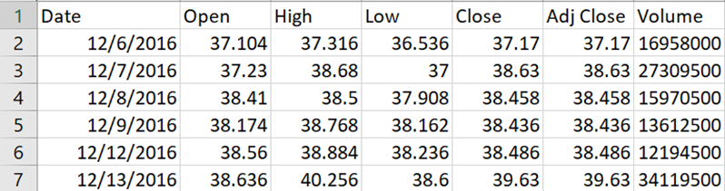
Data Cleaning
Search and clean the missing value
Add new columns
Moving Average (MA)
Exponential Moving Average (EMA)
Percentage change
Clean the data again

Slide 5
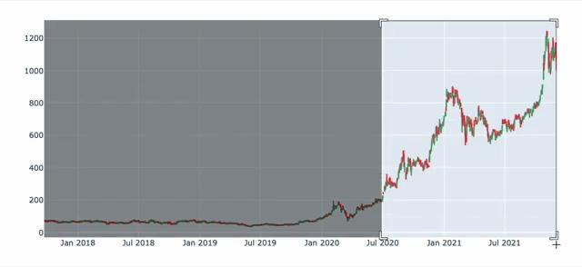
Data Analysis
Candlestick Charts
Provide an interactive view of daily stock price metrics for the three stocks
Color codes to show when the price went up or down.
Filter on different time periods to derive inferences.

Slide 6
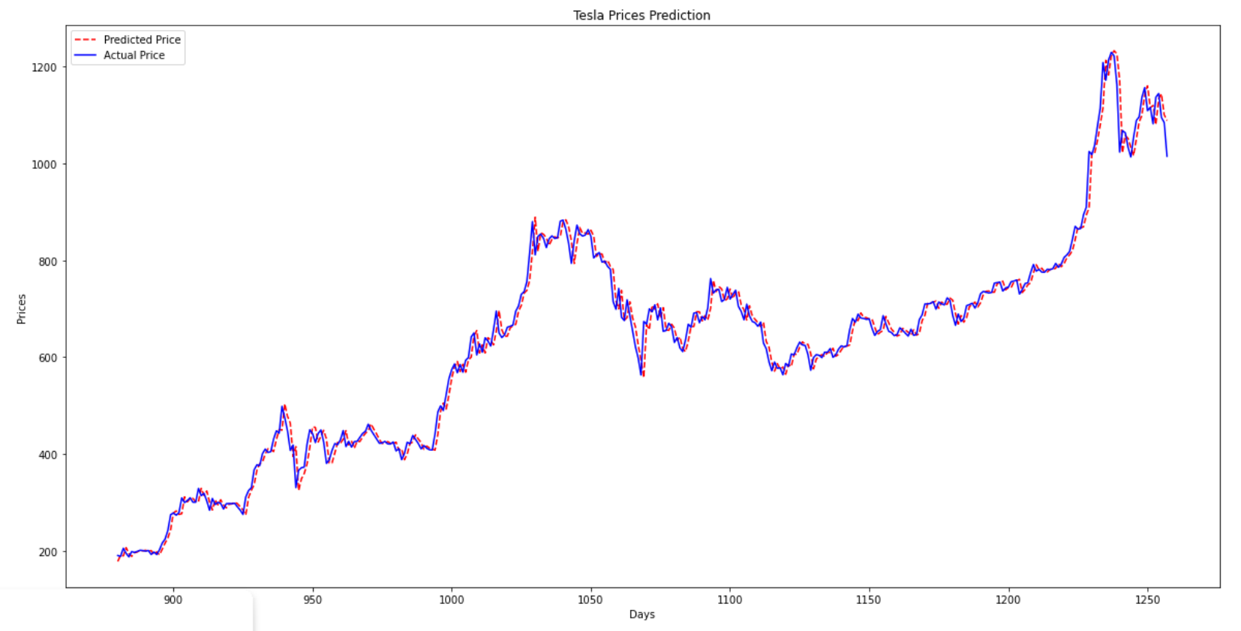
Arima Models
Forecasting model for time-series analysis.
It is widely used for stock market analysis since it is recognised reliable, efficient and capable of predicting short term stock market movements.

Slide 7
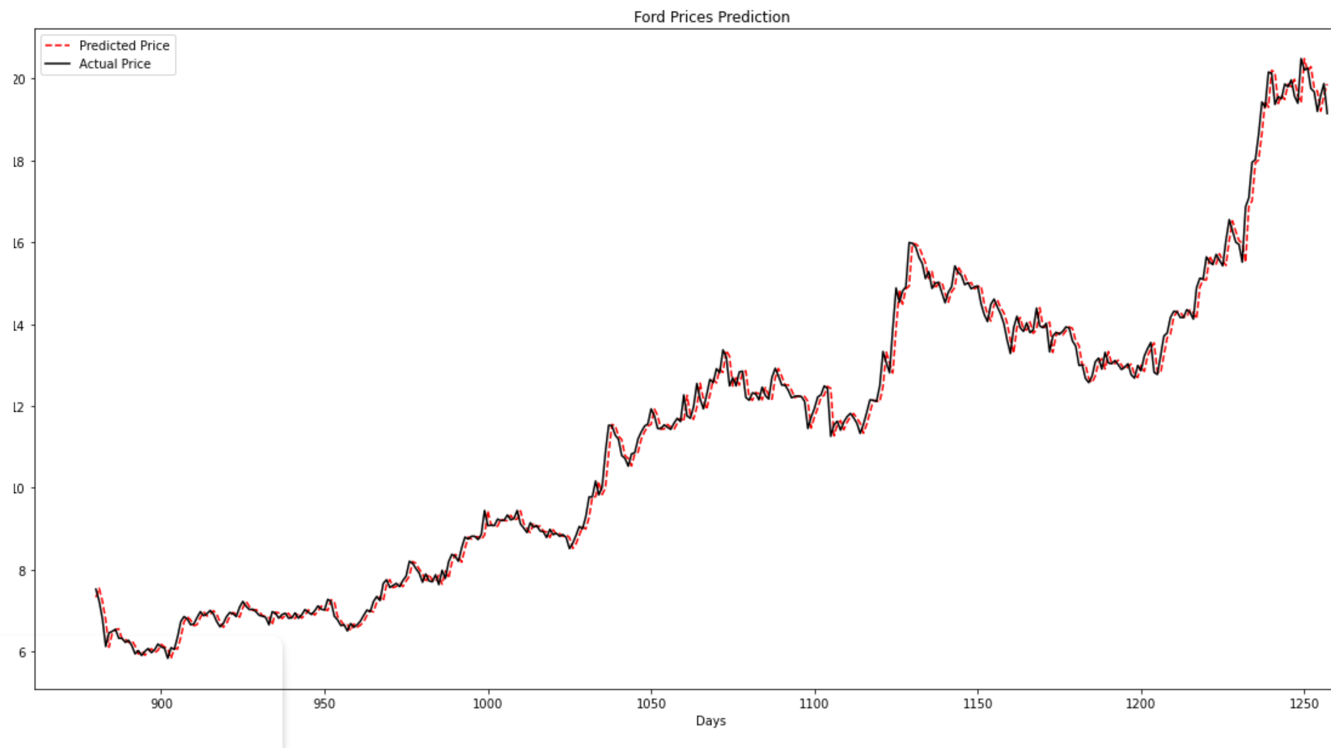

Slide 8
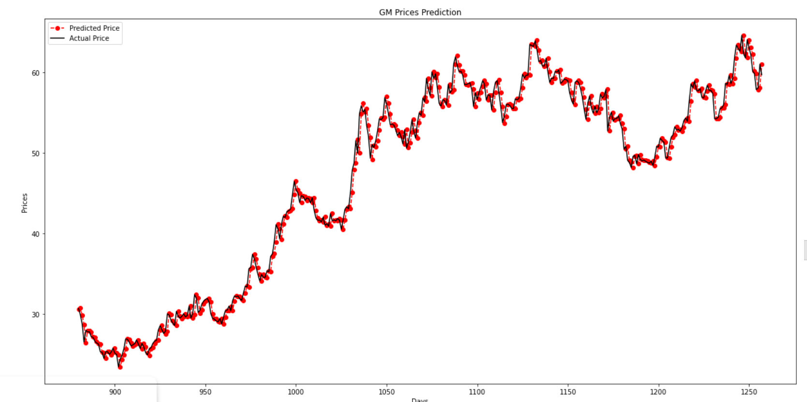

Slide 9
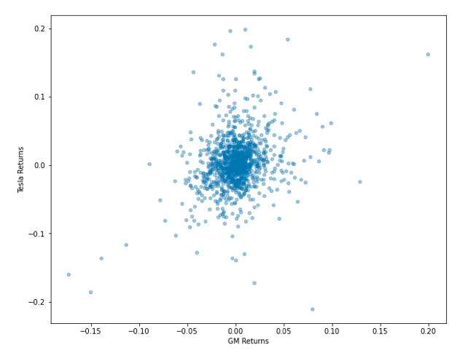
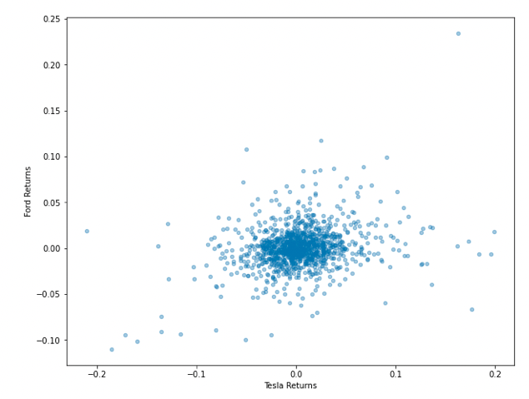
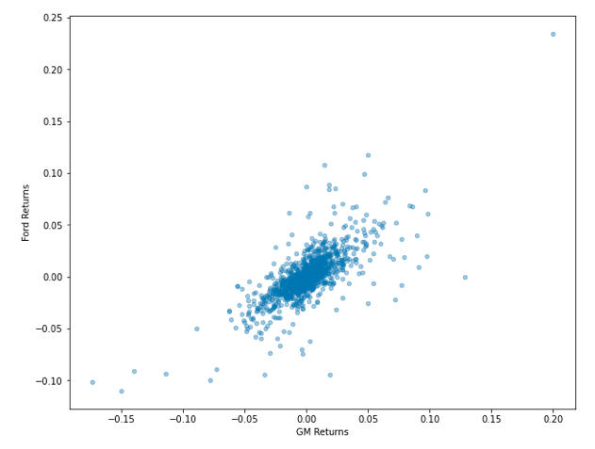
Scatter Plots
We have used scatter plots of daily returns to come up with similarities in the overall returns.
CFO
Vinny Viewer

Slide 10
CONCLUSION
If you want to invest in a stock whose value is steadily rising, then Tesla is the stock for you. This however comes with the risk of volatility.
The volatility can be seen by the dispersed closing prices
If you are looking for stocks that are stable, then GM and Ford are the more viable options but the rate of rise in stock prices is not very high.
The general performance of Ford and GM seem to be similar given the fact that both are old players in the automotive industry and both specialize in traditional (fuel) cars.

Slide 11

So what will happen if you follow our advice?*

Slide 12

So what will happen if you DON’T follow our advice?

Slide 13
Thank you.
* Stock Market investments are subject to market volatility. Please invest according to your heart condition and bank balance.

